Slide 1
PageRank Algorithm
By: Satchit Dahal, Chris Ding and Ben Valdebenito

Slide 2
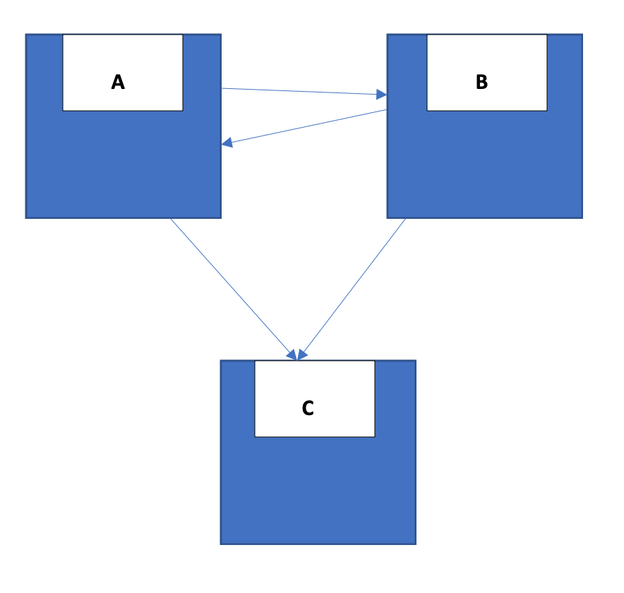

The famous algorithm: Page Rank
P | The page being evaluated
Tn | The number of incoming links
C | The number of outgoing links
d | The damping factor
Notes:
One of the main reasons that makes Google the top search engines in the world is it’s Page Rank algorithm. This formula calculates the rank of the page that is being evaluated and ultimately determines which pages to put on the top of the search results.
The rank of a page is based on the sum of the number of links coming into that page divided by the sum of the number of links going out from that page.
Let’s look at the formula a bit closely.
In this formula, P refers to the the page that is being inputted into the PR formula. Therefore, PR is a function of Page.
T of n is a measure of the inbound link coming into a page. The more inbound links coming into a page, the more value that page has. Here, n is a positive integer that represents the number of the link. For example, n = 1 refers to the first link that comes into the page, n = 100 represents the 100th incoming link.
C is a measure of how many outbound links are going out from one page to another.
In the fgure above, we can see that there is one link going from page A to page B and one link coming in from page B to page A. However since Page C has two links coming in, it’s value is higher than A or B.
How the algorithm knows where to start is due to what’s called a random surfer. It chooses web pages on random. Web pages that had a lot of incoming links were more likely to be chosen by the random surfer. Since it is random, there is also a possibility that it might start all over again from a completely different random page. To work around this problem a damping factor, d.
D is the probability at which the surfer might choose to follow another another link. The value for d is set to 0.85

Slide 3

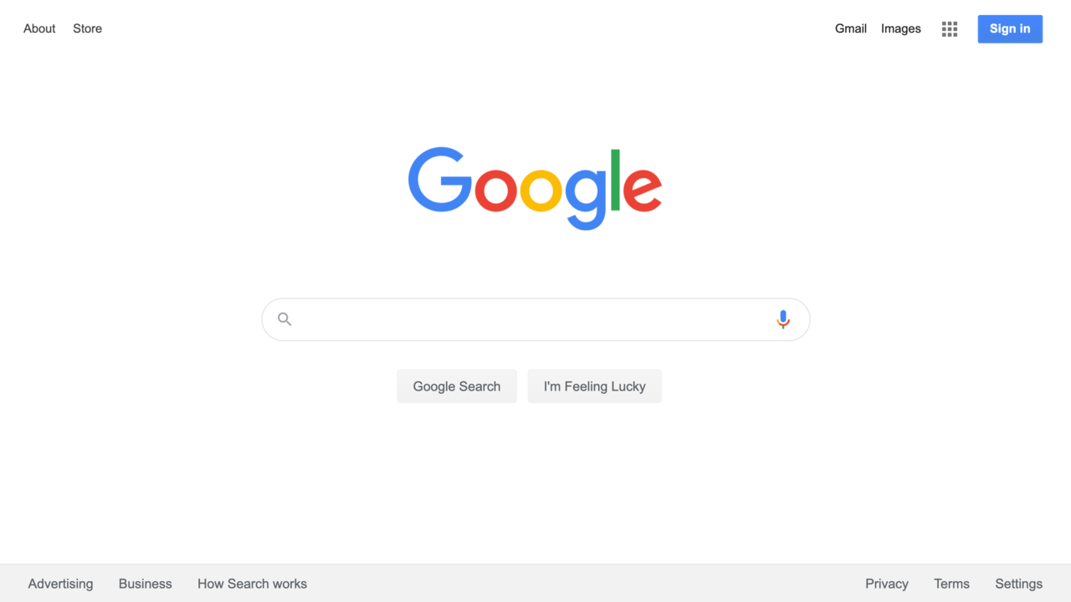
History
Before 1998:
OPIC (On Page Importance Criteria) was the main method
Occurrences of keywords were counted
“Votes” were introduced by backrub in 1996
Ranking factor with links
Abusing links are penalized in 2005
PageRank was an innovative idea from late 1998
Created by Google and Alphabet Founders
Larry Page and Sergey Brin
New kind of search engine
Notes:
Before we jump in and talk about pageRank and how that amazing algorithm helps us find exactly what we need, we should go over how life was before it.
Before 1998, the main way that search algorithm would pull up website was by using OPIC Method. This stands for On-Page Importance Criteria. What this pretty much means, is that it evaluates everything that is in the page, such as keywords, picture and some more keywords. For example, if you want to learn more about the amusement park “Disney World'', you could place that in the searchbar and the search engines back in the days would find the articles with the most instances of the word “Disney World” and place those at the very top. An issue that quickly arose from this type of search method is that an article published by Disney with lots of informative details of the parks may not always appear at the very top. That is because they may not be mentioning “Disney World'' as often as a repetitive poem who mentions “Disney World” in every sentence.
In 1996, ranking factors began to take into account links and were associated with votes. The more incoming links that a website received, the higher votes it has making it more likely to appear at the top of the search. Just as before, this causes the same issues with spammers. This is why later in 2005, websites who abused links connection began being penalized.
In 1998 PageRank was created by Founders of Google and Alphabet, Larry Page and Sergey Brin. Their main goal was to introduce a new kind of search engine to the game. One that wouldn't only use OPIC method, but one that would also look into the quality of the websites linking to it

Slide 4

Common Model:
Random Surfer
Person randomly clicks a link will reach
any page until a dead end.
Model setup
Isolated small internet system;
Four websites.
sOURCE:https://www.google.com/imgres?imgurl=https%3A%2F%2Fcdn.dribbble.com%2Fusers%2F2154802%2Fscreenshots%2F4271609%2Finternet_surfer_1.jpg&imgrefurl=https%3A%2F%2Fdribbble.com%2Fshots%2F4271609-Internet-Surfer&tbnid=tT8XEqBC1wbUaM&vet=12ahUKEwj-gND49ObpAhVYhJ4KHfAtCwAQMygbegQIARBf..i&docid=QTjNhm5Np45EfM&w=800&h=600&q=internet%20surfer&ved=2ahUKEwj-gND49ObpAhVYhJ4KHfAtCwAQMygbegQIARBf
Notes:
The PageRank algorithm outputs a probability distribution based on whether a person who randomly clicks a link will reach any particular page. To better understand this algorithm and combine it with what we learned in class, suppose we have an isolated small internet system of just 4 web pages: www.pageone.com (website1), www.pagetwo.com (website2), www.pagethree.com (website3), and www.pagefour.com (website4), which link to each other, relations shown as image below:

Slide 5
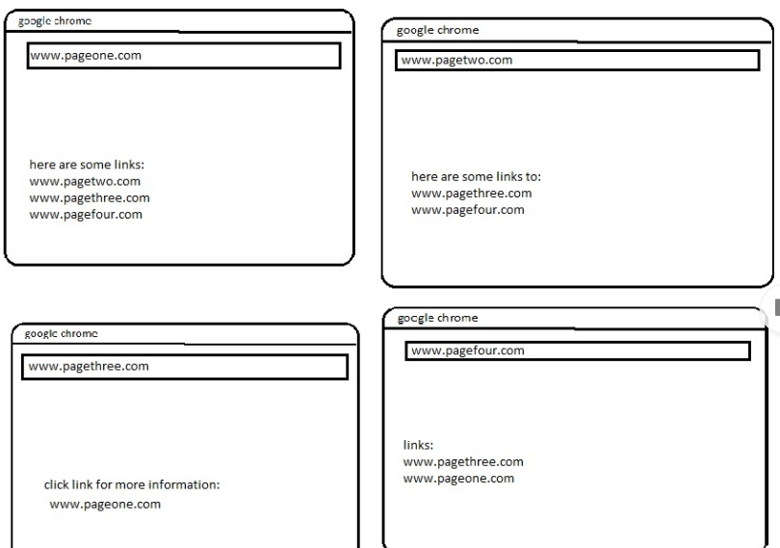

Slide 6
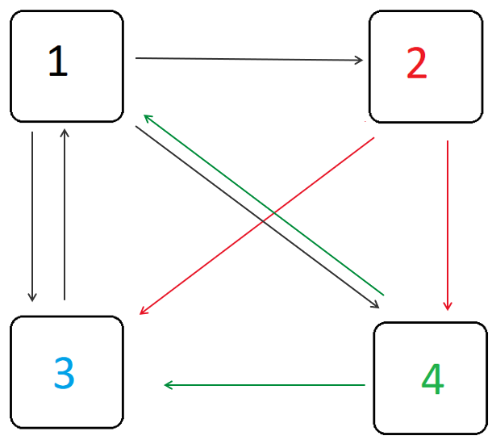
(SOUIRCE: http://pi.math.cornell.edu/~mec/Wint er2009/RalucaRemus/Lecture3/Images/graf1.PNG)
Notes:
In order to get a better view of the algorithm, we set up a model of four different nodes, one for each web site. When site A links to site B, we add a “vector” from A to B in the graph. For example, in figure 1, website1 links to all of the other websites 2,3,and 4. Therefore, in the diagram below, node 1 has 3 outgoing “vectors” to all these nodes. Similarly, website 3 has only one link going to website 1, therefore only one vector goes from node 3 to node 1.

Slide 7
Common Model:
.
Cons:
Unfair for these which has more outgoing links than incoming, less important than the website they link to.
Improvement:
ratio between number of links outgoing from page m to page n to the total number of outgoing links of page m.
Notes:
In our model, every incoming link in the website should be identically important. It is like a president election, every vote needs to be identical to be fair. Thus, according to Figure ii, x1=2,x2=1,x3=3,x4=2. However, by this calculation, it is unfair for website one who has the same amount of incoming links as website four but more outgoing links. In real life scenario, a website might have hundreds of links going out much more than links coming in. It will make websites like msn.com which has more outgoing links than incoming, less important than the website they link to. So we use ratio between number of links outgoing from page m to page n to the total number of outgoing links of page m instead. Here is the graph after improvement:

Slide 8
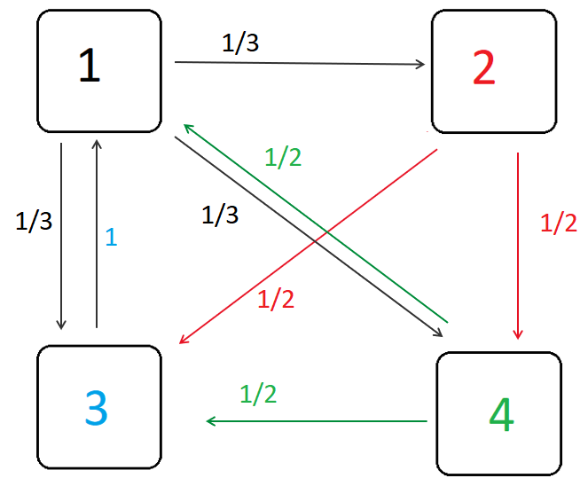
Source:(http://pi.math.cornell.edu/~mec/Winter2009/RalucaRemus/Lecture3/Images/graf2.PNG)
Notes:
We can clearly know how many each link weight now.

Slide 9
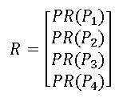
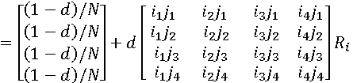
Improved model:
PR values are eigenvector R of an adjacency matrix:
i_{n}j_{m} indicate weights of links, n is the start node and m is the end node.
Ri is the initial probability
Notes:
.Now we have a modified adjacency matrix resized so that each column adds up to one. The PageRank values are eigenvector R of the matrix, for this particular example: these PR represents pr for each node, put the famous formula we discussed in pervious page, it look like this. injm indicate weights of links,n is the start node and m is the end node. for i1j1, it is from node 1 to node 1.
Ri is the initial probability in this case ¼.

Slide 10
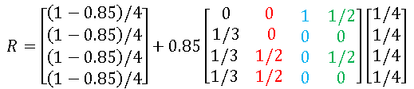

Notes:
For example, The first column represent 3 links outbound from website 1, first row represent 2 links inbound. We all learned how to solve this matrix. We get the PR value for x1, x2,x3=,x4=.

Slide 11
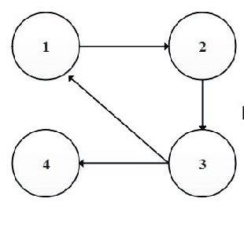
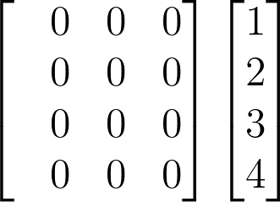
Dangling Nodes
There's risk with everything
Its a link that does not connect to any other links
Makes its importance score zero
Which then makes the rest zero as well
https://www.researchgate.net/figure/The-procedure-to-handle-dangling-nodes_fig1_321056905
Notes:
Just like with anything, new products can have issues with them. The main issue that came with this amazing new method ended up being Dangling Nodes.
A dangling node is a link that does not connect to any other node. If we look at this new example of websites called 1, 2, 3 and 4, we see that website 4 has an incoming link but no outgoing links. At first glance, this may not be an obvious issue. You may be thinking, so what?
Well, by having a node with no outgoing links, it means its importance value will be zero. This means that for website 4 to have an importance value of zero, the summation of all the values coming into website 4 must make it zero. In this example, website 4 has an incoming like from website 3. This would cause website 3 to have an importance value of zero which then causes website one and website 2 to also have an importance score of 0.
This can be represented as a zero matrix shown on the side.

Slide 12
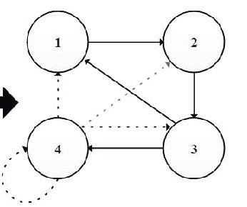
Dangling Node Cont.
Create link from dangling node to all
Evenly distributes weight
Allows the importance score to maintain intact
https://www.researchgate.net/figure/The-procedure-to-handle-dangling-nodes_fig1_321056905
Notes:
A way to fix all of this is creating some connections of our own. To prevent having dangling nodes, we must connect the dangling node in question to itself and all other nodes. By doing this, we will evenly distribute the weight to each node allowing us to maintain the importance score intact for all other nodes.

Slide 13
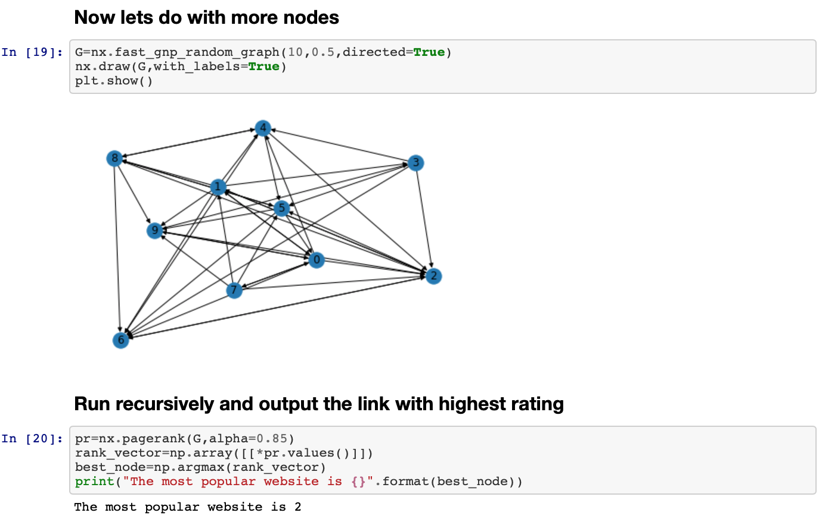
https://github.com/benvb1234/GooglePageRank
Notes:
Valentina Alto

Slide 14
END

